Slide 1
Project On Currency Exchange
By
Nirmalya Datta
Roll No : 2001610130048
Branch: Information Technology

Slide 2
abstract
In finance, an exchange rate between two currencies is the rate at which one currency will be exchanged for another.
It is a useful tool which gives us the value of certain amount of one currency to be converted into a different currency.
It is also regarded as the value of one country’s currency in terms of another currency.
In this project we are going to display a web window in which currency options are given and the conversion value is displayed in the next window.

Slide 3
table of contents
Introduction
Algorithm
Flowchart
Designing
Coding
Conclusion

Slide 4
introduction
Currency converter is a tool used to convert one country’s currency to another.
In this project by the knowledge of usage of currency converter a program is designed in JAVA language.
In this Currency Converter application, it is going to display a web page where you can choose to display the converter or the exchange rate of one currency with all other currencies in the form of table. In the converter you are given a choice to choose two currency names from the list of currency names displayed.

Slide 5
algorithm
Step 1 : Start
Step 2 : Enter the amount value
Step 3 : Select the currency from and to
Step 4 : Click on the convert button
Step 5 : The value will be displayed
Step 6 : Exit

Slide 6
flow chart
0
Start
Input given is amount value and currency names are selected from the options
Click on convert
Given amount value is
Output value will be positive
Output value will be negative
Output will be zero
Stop

Slide 7
designing
We are using different concepts like
HTML for creating web page
SERVLETS for creating dynamic pages
and for displaying output
JDBC for establishing the connection with
the database.

Slide 8
coding
<!DOCTYPE html>
<html lang="en" dir="ltr">
<head>
<meta charset="utf-8">
<title>Currency Converter in JavaScript</title>
<link rel="stylesheet" href="style.css">
<meta name="viewport" content="width=device-width, initial-scale=1.0">
<!-- FontAweome CDN Link for Icons -->
<link rel="stylesheet" href="https://cdnjs.cloudflare.com/ajax/libs/font-awesome/5.15.3/css/all.min.css"/>
</head>
<body>
<div class="wrapper">
<header>Currency Converter</header>
<form action="#">
<div class="amount">
<p>Enter Amount</p>
<input type="text" value="1">
</div>

Slide 9
<div class="drop-list">
<div class="from">
<p>From</p>
<div class="select-box">
<img src="https://flagcdn.com/48x36/us.png" alt="flag">
<select> <!-- Options tag are inserted from JavaScript --> </select>
</div></div>
<div class="icon"><i class="fas fa-exchange-alt"></i></div>
<div class="to">
<p>To</p>
<div class="select-box">
<img src="https://flagcdn.com/48x36/np.png" alt="flag">
<select> <!-- Options tag are inserted from JavaScript --> </select>
</div></div></div>
<div class="exchange-rate">Getting exchange rate...</div>
<button>Get Exchange Rate</button>
</form></div>
<script src="js/country-list.js"></script>
<script src="js/script.js"></script>
</body>
</html>

Slide 10
CSS
/* Import Google Font - Poppins */
@import url('https://fonts.googleapis.com/css2?family=Poppins:wght@400;500;600;700&display=swap');
*{
margin: 0;
padding: 0;
box-sizing: border-box;
font-family: 'Poppins', sans-serif;
}
body{
display: flex;
align-items: center;
justify-content: center;
min-height: 100vh;
padding: 0 10px;
background: #675AFE;
}

Slide 11
::selection{
color: #fff;
background: #675AFE;
}
.wrapper{
width: 370px;
padding: 30px;
border-radius: 7px;
background: #fff;
box-shadow: 7px 7px 20px rgba(0, 0, 0, 0.05);
}
.wrapper header{
font-size: 28px;
font-weight: 500;
text-align: center;
}
.wrapper form{
margin: 40px 0 20px 0;
}
form :where(input, select, button){
width: 100%;
outline: none;
border-radius: 5px;
border: none;
}

Slide 12
form p{
font-size: 18px;
margin-bottom: 5px;
}
form input{
height: 50px;
font-size: 17px;
padding: 0 15px;
border: 1px solid #999;
}
form input:focus{
padding: 0 14px;
border: 2px solid #675AFE;
}
form .drop-list{
display: flex;
margin-top: 20px;
align-items: center;
justify-content: space-between;
}

Slide 13
.drop-list .select-box{
display: flex;
width: 115px;
height: 45px;
align-items: center;
border-radius: 5px;
justify-content: center;
border: 1px solid #999;
}
.select-box img{
max-width: 21px;
}
.select-box select{
width: auto;
font-size: 16px;
background: none;
margin: 0 -5px 0 5px;
}
.select-box select::-webkit-scrollbar{
width: 8px;
}

Slide 14
.select-box select::-webkit-scrollbar-track{
background: #fff;
}
.select-box select::-webkit-scrollbar-thumb{
background: #888;
border-radius: 8px;
border-right: 2px solid #ffffff;
}
.drop-list .icon{
cursor: pointer;
margin-top: 30px;
font-size: 22px;
}
form .exchange-rate{
font-size: 17px;
margin: 20px 0 30px;
}

Slide 15
form button{
height: 52px;
color: #fff;
font-size: 17px;
cursor: pointer;
background: #675AFE;
transition: 0.3s ease;
}
form button:hover{
background: #4534fe;
}

Slide 16
JS
const dropList = document.querySelectorAll("form select"),
fromCurrency = document.querySelector(".from select"),
toCurrency = document.querySelector(".to select"),
getButton = document.querySelector("form button");
for (let i = 0; i < dropList.length; i++) {
for(let currency_code in country_list){
let selected = i == 0 ? currency_code == "USD" ? "selected" : "" : currency_code == "NPR" ? "selected" : "";
let optionTag = `<option value="${currency_code}" ${selected}>${currency_code}</option>`;
dropList[i].insertAdjacentHTML("beforeend", optionTag);
}
dropList[i].addEventListener("change", e =>{
loadFlag(e.target);
});
}

Slide 17
function loadFlag(element){
for(let code in country_list){
if(code == element.value){
let imgTag = element.parentElement.querySelector("img");
imgTag.src = `https://flagcdn.com/48x36/${country_list[code].toLowerCase()}.png`;
}
}
}
window.addEventListener("load", ()=>{
getExchangeRate();
});
getButton.addEventListener("click", e =>{
e.preventDefault();
getExchangeRate();
});

Slide 18
const exchangeIcon = document.querySelector("form .icon");
exchangeIcon.addEventListener("click", ()=>{
let tempCode = fromCurrency.value;
fromCurrency.value = toCurrency.value;
toCurrency.value = tempCode;
loadFlag(fromCurrency);
loadFlag(toCurrency);
getExchangeRate();
})
function getExchangeRate(){
const amount = document.querySelector("form input");
const exchangeRateTxt = document.querySelector("form .exchange-rate");
let amountVal = amount.value;
if(amountVal == "" || amountVal == "0"){
amount.value = "1";
amountVal = 1;
}

Slide 19
exchangeRateTxt.innerText = "Getting exchange rate...";
let url = `https://v6.exchangerate-api.com/v6/25e402aa3613a0e31cbb1212/latest/USD`;
fetch(url).then(response => response.json()).then(result =>{
let exchangeRate = result.conversion_rates[toCurrency.value];
let totalExRate = (amountVal * exchangeRate).toFixed(2);
exchangeRateTxt.innerText = `${amountVal} ${fromCurrency.value} = ${totalExRate} ${toCurrency.value}`;
}).catch(() =>{
exchangeRateTxt.innerText = "Something went wrong";
});
}

Slide 20
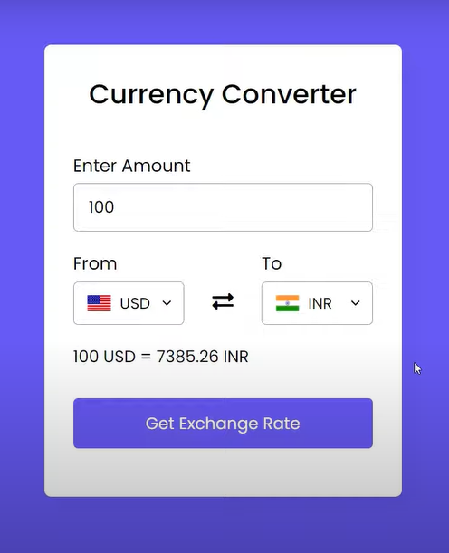
screenshots

Slide 21
conclusion
Therefore, currency converter is developed and is used for knowing the currency’s value.
It can be further developed by including more currency options, and by showing currency values for the user.

